Slide 1
Electric Vehicle Analysis
Automotive Industry
- Pratyush Majumdar

Slide 2
Problem Statement
AtliQ Motors, a leading US-based automotive company specializing in electric
vehicles, currently holds a 25% market share in the EV/hybrid segment in
North America but has less than 2% market share in India. They aim to
expand their presence in the Indian market.
Bruce Haryali, chief of AtliQ Motors India, has tasked the data analytics team,
led by analyst Peter Pandey, to conduct a detailed market study of the
existing EV/hybrid market in India before launching their bestselling models.

Slide 3
Goal
My goal is to analyze the data, extract key insights, and answer both primary and secondary questions. Additionally, I will design an interactive dashboard to effectively visualize trends in electric vehicle data, ensuring that stakeholders can make informed decisions.

Slide 4
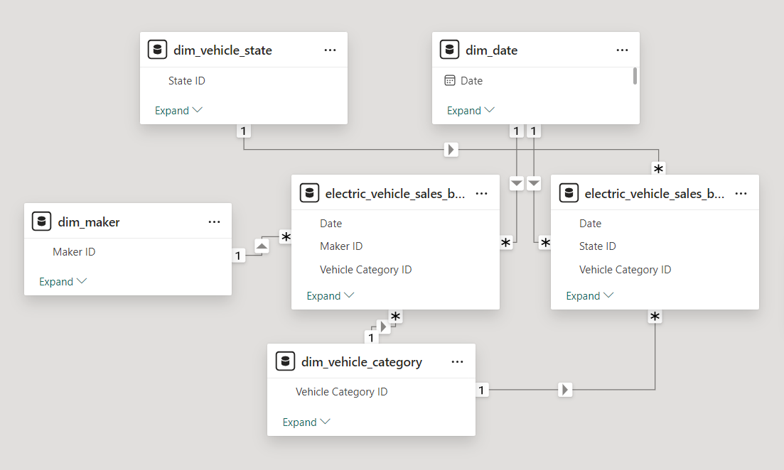
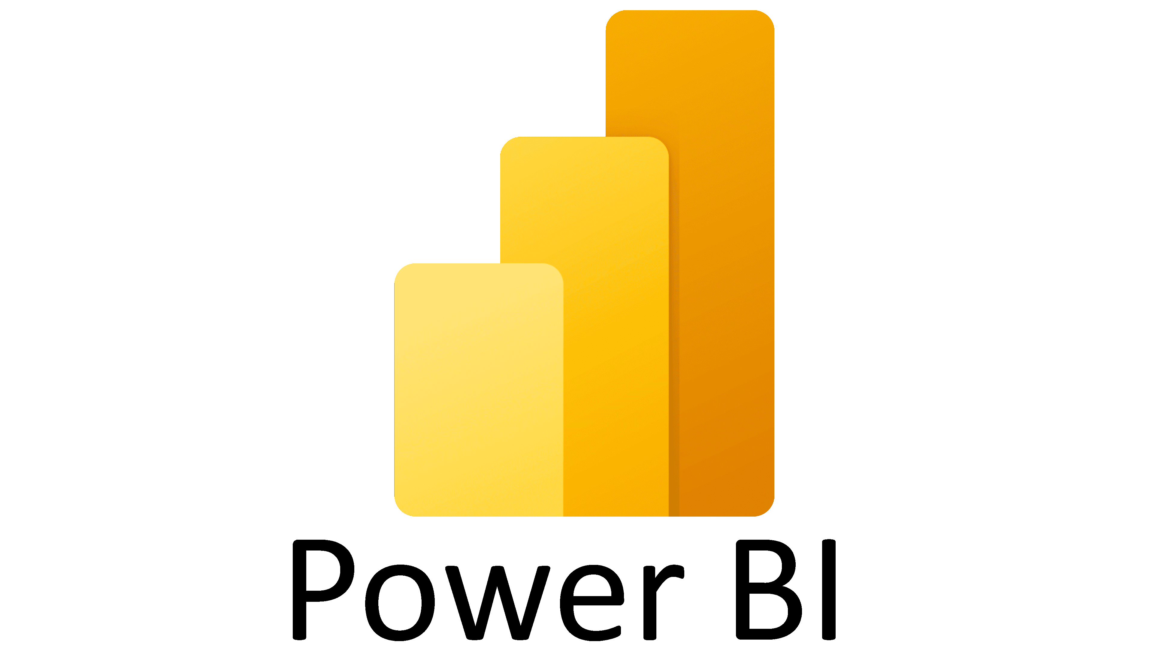
Data Model and Technology Used

Slide 5
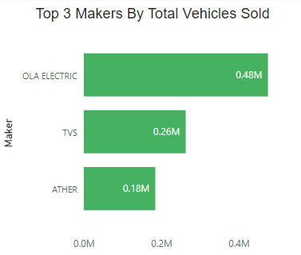
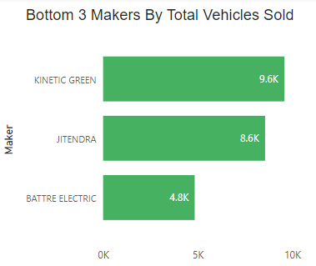
Primary Questions
1) List the top 3 and bottom 3 makers for the fiscal years 2023 and 2024 in
terms of the number of 2-wheelers sold.
Top 3 Makers
Ola Electric
TVS
Ather
Bottom 3 Makers
Kinetic Green
Jitendra
Battre Electric

Slide 6
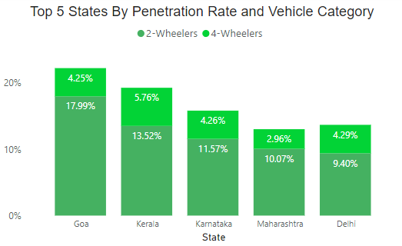
2) Identify the top 5 states with the highest penetration rate in
2-wheeler and 4-wheeler EV sales in FY 2024.
Top 5 States
Goa
Kerala
Karnataka
Maharashtra
Delhi

Slide 7
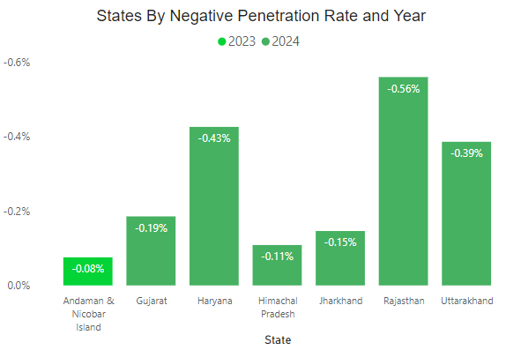
3) List the states with negative penetration (decline) in EV sales from
2022 to 2024?
States
Andaman & Nicobar Island
Gujarat
Haryana
Himachal Pradesh
Jharkhand
Rajasthan
Uttarakhand

Slide 8
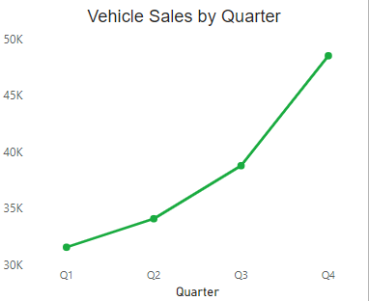
4) What are the quarterly trends based on sales volume for the top 5
EV makers (4-wheelers) from 2022 to 2024?
Insight We can see an upward trend indicating that sales have been increasing every year for the top 5 makers in the 4-wheelers category from 2022 to 2024.

Slide 9
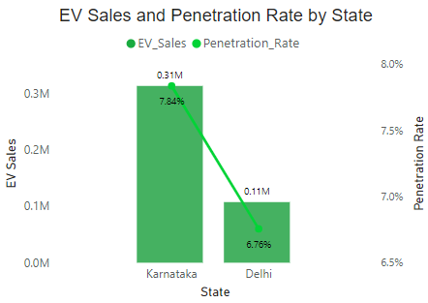
5) How do the EV sales and penetration rates in Delhi compare to
Karnataka for 2024?
Insight The EV sales and penetration rate are higher in Karnataka compared to Delhi.

Slide 10
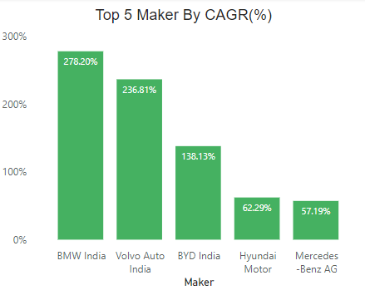
6) List down the compounded annual growth rate (CAGR) in 4-wheeler
units for the top 5 makers from 2022 to 2024.
Top 5 Makers
BMW India
Volvo Auto India
BYD India
Hyundai Motor
Mercedes Benz AG

Slide 11
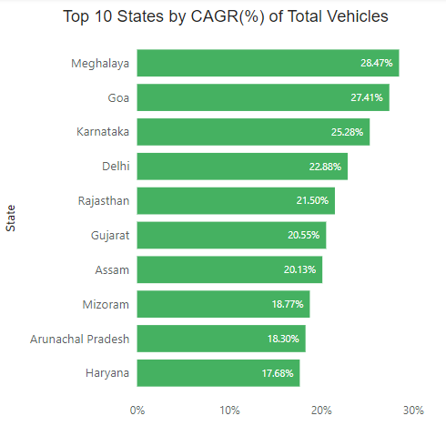
7) List down the top 10 states that had the highest compounded
annual growth rate (CAGR) from 2022 to 2024 in total vehicles sold.
Top 10 States
Meghalaya
Goa
Karnataka
Delhi
Rajasthan
Gujarat
Assam
Mizoram
Arunachal Pradesh
Haryana

Slide 12
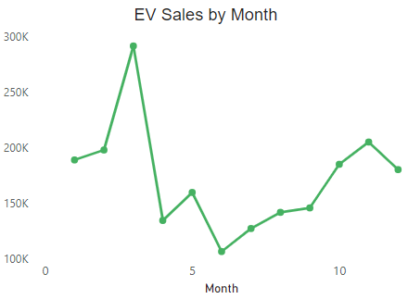
8) What are the peak and low season months for EV sales based on
the data from 2022 to 2024?
Insight The peak season month is March, with the highest sales at 295,187 units, while the low season month is June, where sales drop to 106,709 units.

Slide 13
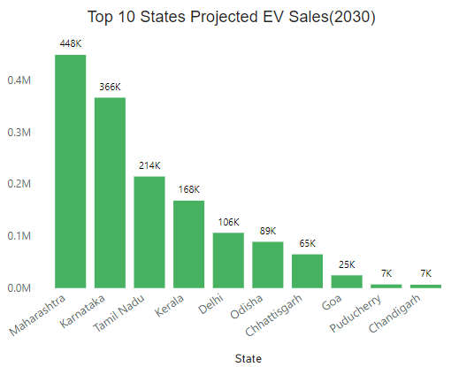
9) What is the projected number of EV sales (including 2-wheelers and
4-wheelers) for the top 10 states by penetration rate in 2030, based on
the compounded annual growth rate (CAGR) from previous years?
Top 10 States
Maharashtra
Karnataka
Tamil Nadu
Kerala
Delhi
Odisha
Chhattisgarh
Goa
Puducherry
Chandigarh

Slide 14
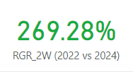

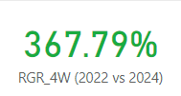
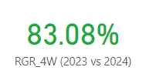
10) Estimate the revenue growth rate of 4-wheeler and 2-wheelers EVs
in India for 2022 vs 2024 and 2023 vs 2024, assuming an average unit price.
RGR 2-Wheelers
2022 vs 2024 – 269.28%
2023 vs 2024 – 28.13%
RGR 4-Wheelers
2022 vs 2024 – 367.79%
2023 vs 2024 – 83.0%

Slide 15
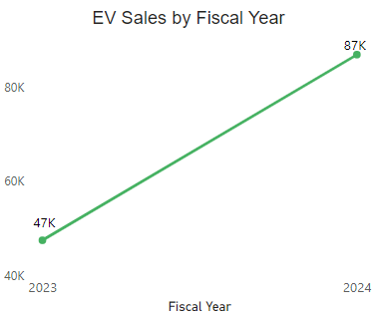
Secondary Questions
1) What are the primary reasons for customers choosing 4-wheeler EVs in 2023 and 2024 (cost savings, environmental concerns, government incentives)?
Fuel Savings: With rising fuel prices, EVs offer a more economical alternative in the long run, as electricity costs are generally lower and more stable than gasoline prices.

Slide 16
Reducing Carbon Footprint: Many consumers are increasingly aware
of their environmental impact and choose EVs to reduce their carbon
emissions.
Tax Benefits: Various governments offer like tax credits, rebates, and other
financial incentives are provided to EV buyers, making the overall cost more
attractive.
Technological Advancements: Improvements in battery technology, increased
driving range, and faster charging options have made 4-wheeler EVs more
practical and appealing.

Slide 17
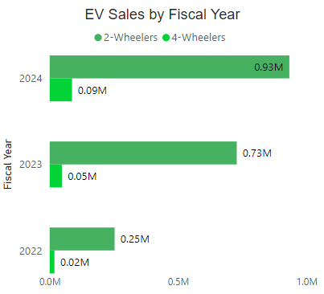
2) How do government incentives and subsidies impact the adoption
rates of 2-wheelers and 4-wheelers? Which states in India provided most
subsidies?
Cost Reduction: Subsidies lower the initial purchase price of EVs, making them more competitive with traditional internal combustion engine (ICE) vehicles. This
financial benefit encourages more consumers to opt for EVs.

Slide 18
Boosting Production and Infrastructure: Subsidies are often
extended to manufacturers to boost the production of EVs and related
infrastructure, such as charging stations. This, in turn, enhances consumer
confidence in the availability and convenience of using EVs.
States providing high subsidies
Delhi
Maharashtra
Gujarat
Telangana

Slide 19
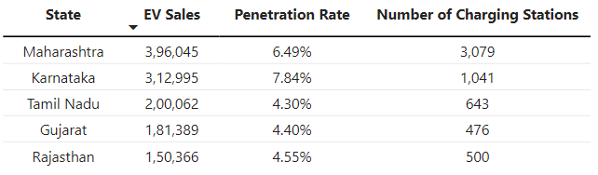
3) How does the availability of charging stations infrastructure
correlate with the EV sales and penetration rates in the top 5 states?
Higher Charging Stations, Higher Sales: Maharashtra, with the most charging stations, has the highest EV sales, suggesting a positive correlation between the availability of charging infrastructure and EV sales.
Top 5 States
Maharashtra
Karnataka
Tamil Nadu
Gujarat
Rajasthan

Slide 20
4) Who should be the brand ambassador if AtliQ Motors launches
their EV/Hybrid vehicles in India and why?
Bruce Haryali could be an excellent choice for the brand ambassador role. His leadership as the chief of AtliQ Motors India would make him a credible and authoritative figure, reinforcing the brand's vision and dedication to bringing cutting-edge, eco-friendly vehicles to the Indian market.
Using an internal figure like Bruce could also help build trust and foster a strong connection with the audience, demonstrating that the company is led by someone deeply invested in the local market and its environmental goals.

Slide 21
5) Which state of India is ideal to start the manufacturing unit?
(Based on subsidies provided, ease of doing business, stability in
governance etc.)
Maharashtra is an ideal state for setting up a manufacturing unit due to several factors: Subsidies & Incentives: Maharashtra offers several incentives under its Industrial Policy, including capital subsidies, interest subsidies, and concessions on electricity tariffs.
Ease of Doing Business: Maharashtra consistently ranks high in ease of doing business rankings, with streamlined processes for setting up industries.

Slide 22
Infrastructure: Strong infrastructure with well-developed ports,
highways, and industrial zones.
Governance: Stable government policies and a robust industrial ecosystem.
Key Industrial Areas: Mumbai, Pune, Nagpur, Nashik.

Slide 23
6) Your top 3 recommendations for AtliQ Motors.
Localized Market Research: Conduct thorough market research to understand the unique needs, preferences, and challenges of Indian consumers. Infrastructure Development: Collaborating with local governments and energy companies to establish a network of charging stations will ease consumer concerns about range anxiety and encourage EV adoption.
Sustainability and Brand Positioning: Position AtliQ Motors as a leader in sustainable and innovative transportation solutions. Highlight your commitment to reducing carbon footprints and advancing green technology.

Slide 24
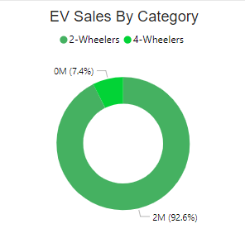
Additional Insights
1) Nationwide, EV sales for 2-wheelers have outpaced those of 4-wheelers, highlighting the growing popularity and adoption of 2-wheeler electric vehicles.

Slide 25
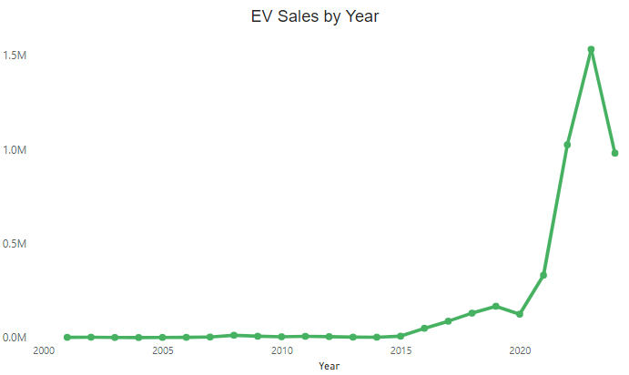
2) EV sales remained stable until around 2015, followed by a sharp
increase. Sales continued to rise, reaching a peak around 2019. However,
there was a noticeable decline from 2019 to 2020, but the trend shows that
sales started increasing again after this dip.

Slide 26
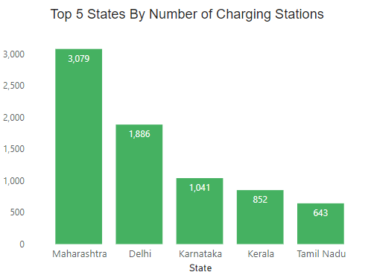
3) Maharashtra and Delhi lead in EV charging infrastructure, suggesting
strong regional support for electric vehicles. States like Tamil Nadu and
Kerala, with fewer charging stations, might represent areas of opportunity
for expanding EV infrastructure, which could be crucial for wider adoption
of electric vehicles.
Top 5 States
Maharashtra
Delhi
Karnataka
Kerala
Tamil Nadu

Slide 27
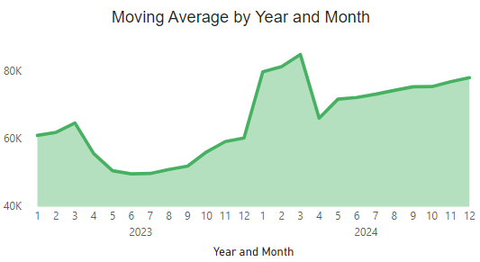
4) From the moving average analysis, we can observe that average EV
sales showed an upward trend from December 2023 to March 2024,
followed by a brief decline for one month. However, the sales started to
increase again, indicating a resilient growth pattern.

Slide 28
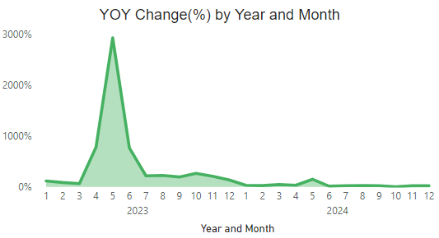
5) The Year-over-Year (YoY) analysis reveals a significant spike in May
2023, indicating exceptionally high sales during that month.

Slide 29
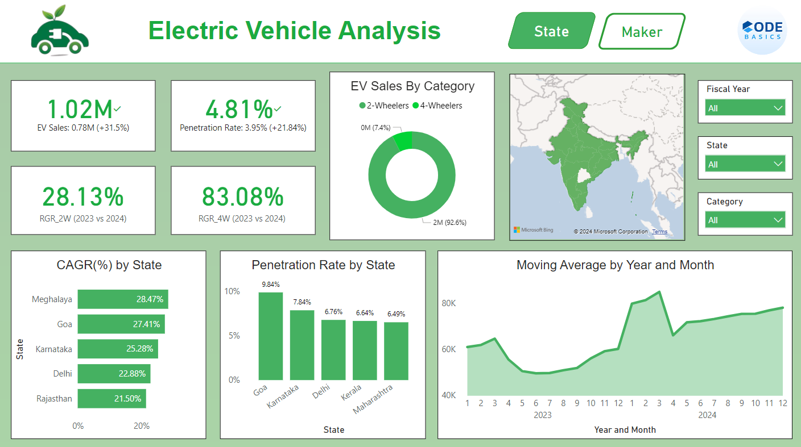
Dashboard
Dashboard Link: Electric Vehicle Analysis

Slide 30

Thank You
The future Is electric. Join the ride!

